Slide 1
虚拟语气
大学英语
Lesson 15

Slide 2
Lead-in: Exercises
1. If my father _____ here now, he _____ tell me what to do.
A. were; would B. was; will
C. had been; would D. is; will
2. I advised that you _____ the job as soon as possible.
A. finished B. finishing
C. to finish D. finish
3. I wish I _____ a bird.
A. is B. were C. will be D. are
4. I’d rather you _____ me the news.
A. not tell B. not to tell
C. didn’t tell D. hadn’t told
A
D
B
D

Slide 3
什么是语气
第一章

Slide 4
I.什么是语气？
语气是动词的一种形式，用以表示说话人对某种言行或某种事情的看法或态度。
英语有三种语气：陈述语气，祈使语气和虚拟语气。
不同的语气用动词的不同形式（有的还借助句法形式）来表示。

Slide 5
陈述语气一般用来讲述事实或提出疑问。常常用于陈述句、疑问句和感叹句。
e.g. I took a shower after supper.
What are you going to do?
What a beautiful flower!
祈使语气主要用于祈使句。
e.g. Get out of here!

Slide 6
什么是虚拟语气
第二章

Slide 7
II. 什么是虚拟语气？
虚拟语气是一种特殊的动词形式，表示说话人所说的话不是事实，而是想象、假设、建议、打算、意见、愿望、怀疑、推测、喜悦等等。
一是用来表示说话人所说的话不是一个事实，而是一种假设、猜测、怀疑等(常用在条件状语从句中或让步状语从句中)；
一是表示说话人的愿望、要求、命令、建议等 (常用在名词性从句中)。
简言之，即：不是事实或不大可能发生的事情，就用虚拟语气来表述

Slide 8
II. 什么是虚拟语气？
e.g. If we had met her last night, we would have told her what had happened.
如果我们昨晚见到她，我们就会告诉她发生了什么事。
（实际上，我们并没有见到她，也没有告诉她所发生的事。）

Slide 9
虚拟语气的基本形式
第三章

Slide 10
虚拟语气的形式
非真实条件句中的用法
（if 引导的虚拟条件句）
名词性从句中的用法
虚拟
语气
状语从句中的用法
含蓄条件句中的用法
其他固定用法

Slide 11
非真实性条件句是虚拟语气最基本的表现形式。
一、If 引导的条件句
1. if真实条件句 表示条件是真的或有可能实现的, 采用陈述语气。
2. if虚拟条件句 表示条件是虚拟的或几乎无法实现的, 采用虚拟语气。

Slide 12
if真实条件句用于陈述语气,假设的情况很有可能发生,其中if是“如果”的意思。
if条件从句
一般现在时
主句
will \shall+动词原形
情态动词 + 动词原形

Slide 13

If we have chances, we can have further cooperation.

Slide 14
if虚拟条件句 表示条件是虚拟的或几 乎无法实现的, 采用虚拟语气。

Slide 15
if 引导的虚拟条件句
①与现在事实相反
②与过去事实相反
③与将来事实可能相反

Slide 16
if虚拟条件句
 | if虚拟条件句 | 主句
与现在事实相反的假设
If+主语+ 动词的过去式
（be动词一般用were)
主语+would ( should / might / could )＋动词原形
即：If+一般过去时态
（be动词一般用were)

Slide 17
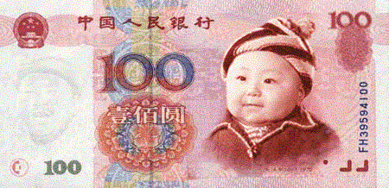

If I had a great deal of money, I would buy a villa (别墅) for my parents.
与现在事实相反

Slide 18
if虚拟条件句
 | if虚拟条件句 | 主句
与过去事实相反的假设
If+主语+had +动词的过去分词
主语 + would ( should / might / could )＋have done
即：If+过去完成时态

Slide 19

与过去事实相反
If he had got up earlier , he could have caught the train.

Slide 20
if虚拟条件句
 | if虚拟条件句 | 主句
与将来事实相反的假设
1、If+主语+动词过去式
2、If+主语+were to+ 动词原形
3、If+主语+should +动词原形
主语+would ( should / might / could )＋动词原形

Slide 21
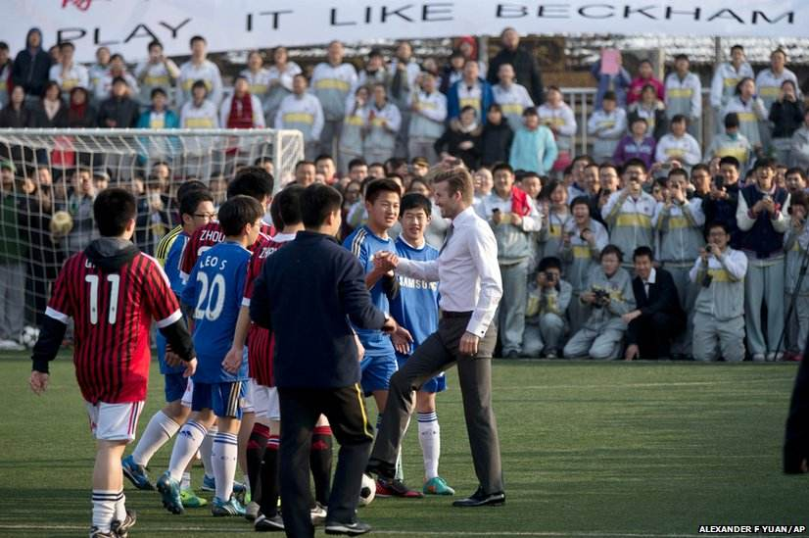
与将来事实相反
If I met Beckham some day, I would shake hands with him.
If I were to meet Beckham some day, …
If I should meet Beckham some day, …

Slide 22
总结
 | if虚拟条件句 | 主句
与现在事实相反的假设
与过去事实相反的假设
与将来事实相反的假设
If+主语+ 动词的过去式
（be动词一般用were)
主语+would ( should / might / could )＋动词原形
即：If+一般过去时态
（be动词一般用were)
If+主语+had +动词的过去分词
主语 + would ( should / might / could )＋have done
即：If+过去完成时态
1、If+主语+动词过去式
2、If+主语+were to+ 动词原形
3、If+主语+should +动词原形
主语+would ( should / might / could )＋动词原形

Slide 23
注意
在主句中，should一般只与第一人称搭配，could和might各人称都可以使用，但would是最普遍，最常见的。

Slide 24
注意以下问题：
1. 错综时间虚拟条件句
2. (if省略) 倒装虚拟条件句
3. 含蓄条件句

Slide 25
1. 错综时间虚拟条件句
即：if虚拟条件句与主句的时间不一致。
1). If you had followed my advice, you would be able to finish the work now.
如果你当时听了我的话，现在就能完成这份工作了。
（从句说明过去，主句说明现在。）
2). If I were you, I would have gone to her birthday party.
如果我是你，我就去参加她的生日晚会了。
（从句说明现在，主句说明过去。）

Slide 26
错综时间条件句
（4+1）
 | if虚拟条件句 | 主句
与现在事实相反的假设
与过去事实相反的假设
与将来事实相反的假设
If+主语+ 动词的过去式
（be动词一般用were)
主语+would ( should / might / could )＋动词原形
即：If+一般过去时态
（be动词一般用were)
错综时间条件句
错综时间条件句
If+主语+had +动词的过去分词
主语 + would ( should / might / could )＋have done
即：If+过去完成时态
1、If+主语+动词过去式
2、If+主语+were to+ 动词原形
3、If+主语+should +动词原形
主语+would ( should / might / could )＋动词原形

Slide 27
2. (if省略) 倒装虚拟条件句
在虚拟条件句中，如果条件句中有were, had（助动词）或should时，可使用倒装结构，把were，had，should提前，省略if。
若条件从句为否定句，否定词not应置于主语之后，而不能与were，should，had等缩略成weren’ t，shouldn’t，hadn’ t置于句首。

Slide 28
1). Had I seen him then, I would have been very happy.
= If I had seen him then, I would have been very happy.
2). Should I have time, I would go with you.
= If I should have time, I would go with you.
3). Were I not so busy, I would go with you.
= If I were not so busy, I would go with you.

Slide 29
3. 含蓄条件句
有时为了表达的需要，在虚拟语气中并不总是出现if引导的条件句，而通过其他手段来代替条件句。

Slide 30
（1）用介词短语代替条件状语从句．常用的介词有with, without, but for，under 等。如：
What would you do with a million dollars?
We could not have finished the work ahead of time without your help.
But for the rain, we would have finished the work.
=If you had a million dollars, what would you do?
=If we hadn’ t got your help / If you hadn’ t helped us, …
=If it hadn’ t been for the rain, …

Slide 31
（2）用or，otherwise，but，but that等连词表示不具备条件
直陈语气
虚拟语气
(1) I was ill that day. Otherwise, I would have taken
part in the sports meet.（副词）
虚拟语气
直陈语气
(2) I might have given you more help, but I was too
busy.（连词）

Slide 32
实战练习 1
We didn't know his telephone number, otherwise we _____ him,
A) would have telephoned
B) must have telephoned
C) would telephone
D) had telephoned
A

Slide 33
解题思路
本题是与过去时相反的虚拟句，从句中用过去完成式，主句中用would have done。
本句相当于If we had known his telephone number，we would have telephoned him。
答案是A) would have telephoned。

Slide 34
（3）某些暗含虚拟条件句，虚拟条件也可以通过分词短语、名词短语或上下文等表现。
谓语动词根据情况用should/would/could/might+动词原形 或 should/would/could/might have+过去分词
1) Cooked a little longer, the meat would be more delicious.
煮得久一点，这肉会更加美味的。
2) A few hours earlier, you would have seen the famous writer.
要是你早来几个小时，你就会见到那位著名的作家了。

Slide 35
二. 名词性从句中的虚拟语气

Slide 36
1.虚拟语气在主语从句中的运用
二. 名词性从句中的虚拟语气
在“It is + 某些形容词（或过去分词）+主语从句”的句型中，主语从句中的动词形式用“should + 动词原形 （should可以省略）”。
常用的形容词有：necessary, important, essential, obligatory, vital, impossible, strange, urgent, desirable, natural, advisable, preferable等等
常用的过去分词通常是表示提议、要求、命令等动词的过去分词。例如：decided, arranged, suggested, required, demanded, urged, proposed, recommended, ordered, desired, advised…

Slide 37
e.g. It is advisable that a general announcement be made to the staff.
最好给全体人员发个通知。
需要给这台机器加润滑油了。
It is required that the machine (should) be oiled.
已决定推迟会议。
It has been decided that the meeting (should) be put off.

Slide 38
实战练习
It is necessary that an efficient worker ___ his work on time.
finishes
can finish
finish
has finished
答案: C

Slide 39
2. 虚拟语气在宾语从句中的应用
在表示提议、要求、命令、意志等动词之后的宾语从句中，可以用 “should + 动词原形（should可以省略）”形式做谓语。
这类动词有：advise, ask, beg, determine, require, suggest, request, demand, urge, propose, command, desire, insist, prefer, order, pray, recommend 等等

Slide 40
e.g. She insisted that the seat (should) be booked in advance.
她坚持要预定座位。
他们要求他唱支歌。
They requested that he (should) sing a song.
我建议推迟会议。
I suggest that the meeting (should) be put off.

Slide 41
实战练习
We desire that the tour leader us immediately of any change in plans.
A. inform
B. informed
C. informs
D. has informed
A

Slide 42
3. 虚拟语气在表语从句、同位语从句中的应用
在demand, motion, idea, proposal, suggestion, order, recommendation, requirement, decision, advice等表提议、要求、命令等名词之后的表语从句、同位语从句中，谓语动词可用“should + 动词原形 （should可以省略) ”形式。

Slide 43
e.g. He issued the order that the troops (should) withdraw at once.
他命令部队马上撤退。
我的建议是我们派几个同志去帮助别的小组。
My suggestion is that we (should) send a few comrades to help the other groups.
他发出命令要求立即完成这项工作。
He gave the order that the work be done at once.

Slide 44
实战练习
The suggestion that the mayor the prizes was accepted by everyone.
A. would present
B. present
C. ought to present
D. presents
B

Slide 45
小结：名词性从句中的虚拟语气
一 “坚持”(insist)
二“命令” (order, command)
四“建议”(advise, suggest, propose, recommend)
五“要求” (ask, demand, require, request, desire)
六 “情感、情绪”（pity，shame, no wonder, amazing, surprizing.....）(书P43)
+ (that) sb (should) do ...
或是 (that) sb / sth (should) be done

Slide 46
我们建议Tom 去休息一下。
他坚持要我与他同行。
他们要求派Tom去那儿工作。
老师要求作业要及时完成。
(that) Tom have a rest
We suggested ___________________ .
(that) I (should ) go with him
He insisted _________________________ .
They requested (that) Tom _________________________________ .
(should) be sent to work there
The teacher asked (that) our homework _________________________________ .
(should) be finished in time

Slide 47
3. wish之后宾语从句中动词的三种形式
与现在事实相反: 一般过去时( be 用were )
与过去事实相反: 过去完成时
与将来事实相反: would/could +V.原
1. wish 的宾语从句

Slide 48
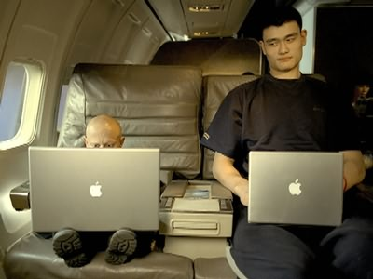
I wish I _____ (be) as tall as Yao Ming.
were

Slide 49
I wish/wished I ______ (have not) eaten so much watermelon.
hadn’ t

Slide 50
I wish it ______ ( will ) rain tomorrow. If so, I can stay at home to have a good sleep.
would

Slide 51

He wishes he ___________________ ( become ) a scientist some day.
could / would become

Slide 52
三. 虚拟语气在状语从句中的用法
1. 方式状语从句中的用法
as if /
as though
似乎，
好像
与现在事实相反: 一般过去时( be 用were )
与过去事实相反: 过去完成时
与将来事实相反: would/could + V.原 (了解)
与 wish 的宾语从句相似

Slide 53
He behaves as if he owned the house.
1). 从句的动作与主句动作同时发生 (可以理解成与现在事实相反)
He behaves as if he were the owner of the house.
2). 从句的动作发生在主句动作之前 (可以理解成与过去事实相反)
She talked about Rome as though she had been there herself.
3). 从句的动作发生在主句动作之后 (可以理解成与将来事实相反)
He coughed (咳嗽) twice as if someone would come.

Slide 54
注意：P46
as if/ as though 引导的从句，既可以用陈述语气，表示事实或实现的可能性比较大；也可以用虚拟语气，表示不符合事实或与事实相反的情况。
He talks as if he is drunk. (事实，陈述)
Tom behaves as if nothing had occured.(与过去事实相反，虚拟)

Slide 55
三. 虚拟语气在状语从句中的用法
2. 目的状语从句中的用法
so that，
in order that
can，may，should，will，could，might，would + V.原 (以便；为了)
+
I go to bed early so that I can have a good sleep.

Slide 56
三. 虚拟语气在状语从句中的用法
2. 目的状语从句中的用法
lest, for fear, in case
should + V.原 (免得，以免，以防，唯恐)
+
He took an umbrella lest it should rain.

Slide 57
三. 虚拟语气在状语从句中的用法
3. 让步状语从句中的用法
even if/ even though虚拟
等同于if引导的虚拟情况
尽管
Even if I had the talent to play tennis I couldn't stand the pressure.
即使我有打网球的天资，我也承受不了那种压力。

Slide 58
四. 虚拟语气特殊句型与固定句式:
sb did …
与现在或将来情况相反
1. would rather
宁愿，但愿
sb had done …
与过去情况相反
I would rather you returned me my money now.
I would rather you came tomorrow.
I would rather we hadn’ t told her the bad news.

Slide 59
实战练习
I’d rather you make any comment on the issue for the time being.
A. don’t B. didn't
C. wouldn't D. shouldn't
B

Slide 60
3. It is (high / about ) time
(that)
“是时候…... (做某事)”
注意: should不能省略．
sb did
sb should do

Slide 61

是时候采取措施来保护环境了。
It is ( high / about ) time that we took / should take measures to protect the environment.
你该走了。
It’ s (high / about) time that you went.

Slide 62

4. If only … ! 要是……就好了
与现在事实相反: 一般过去时( be 用were )
与过去事实相反: 过去完成时
If only
If only it stopped raining now!
If only we had followed your advice!

Slide 63
实战练习
If only the committee the regulations and put them into effect as soon as possible.
A. approve
B. can approve
C. will approve
D. would approve
D

Slide 64
总结
与现在情况相反的时候，谓语动词用过去时！
与过去情况相反的时候，谓语动词用had + 过去分词形式！
主句中如果出现有表示命令，提议，要求，意志方面的词时，一定要警觉！99%的可能性就是要考虚拟语气！一般考的就是“should + 动词原形”这一形式，往往在“动词原形”中考被动语态，在正确选项中往往把should省略掉，而成be done 的形式，要特别注意这一点！！

Slide 65
虚拟语气的解题对策
1. 判断是否虚拟
2. 判断虚拟类型
3. 判断虚拟时间
Pass!

Slide 66
Fill in the blanks with the verbs given in brackets, paying special attention to the subjunctive mood.
would accept
1) If I were you, I ( accept ) _______________ the job.
2) If they were here tomorrow, the problem (solve) _______________.
3) Luckily I was wearing a seat belt. If I hadn’t been wearing one, I (injure) _____________________________________________ seriously.
4) Were it for their help, we (not overcome) _______________________ the difficulties.
5) If we hadn’t got everything ready by now, we (have) ____________ a terrible time tomorrow.
6) He works with such enthusiasm as if he never (know) _______ fatigue (疲倦).
7) He wouldn’t have been saved even if he (send) ______________ to hospital at once.
would be solved
would / should / could / might have been injured
would not have overcome
would have
knew
had been sent

Slide 67
8) If only I (take) __________ your advice at that time!
9) We wish that people everywhere (show) ________ more concern for the environment around them.
10) Modern business and industry demand that every manager (know)
______________ much about economic management.
11) It is desired that this rule (obey) ___________________ by everyone
working here.
12) It is a great pity that he (be) ___________ so stubborn (顽固).
13) It is high time that you (learn) ______________ English and computer well.
14) I would rather that Mr. Williams (make) ___________ the speech at the
conference instead of the dean that day.
15) He would sooner you (not see) __________ him any more in the future.
had taken
showed
(should) know
(should) be obeyed
(should) be
learned / learnt
had made
did not see

Slide 68
谢谢聆听
单击此处输入你的副标题，文字是您思想的提炼，请尽量言简意赅的阐述观点，以便观者可以准确理解您所传达的信息。

